Slide 1
9/11/2024 Target Selection
This lecture is intended to help you achieve the following learning objective: Analyze the prospects of a biological macromolecule (usually a protein) as a target for ligand design, from a community, scientific, and business perspective.
This module will consist of a lecture interspersed with discussions, an interactive database search exercise, and a review
At the end of this module, you should be able to address the question of what is necessary and what is desirable for a biological macromolecule to be a suitable target for structure-based drug design.
What is necessary/desirable about the physiological role?
What is necessary/desirable about the structural properties?
What are some business considerations that pharmaceutical companies use to decide whether to develop a drug for a particular target?
You should also know about some databases that you can use to help find a suitable target for SBDD

Slide 2
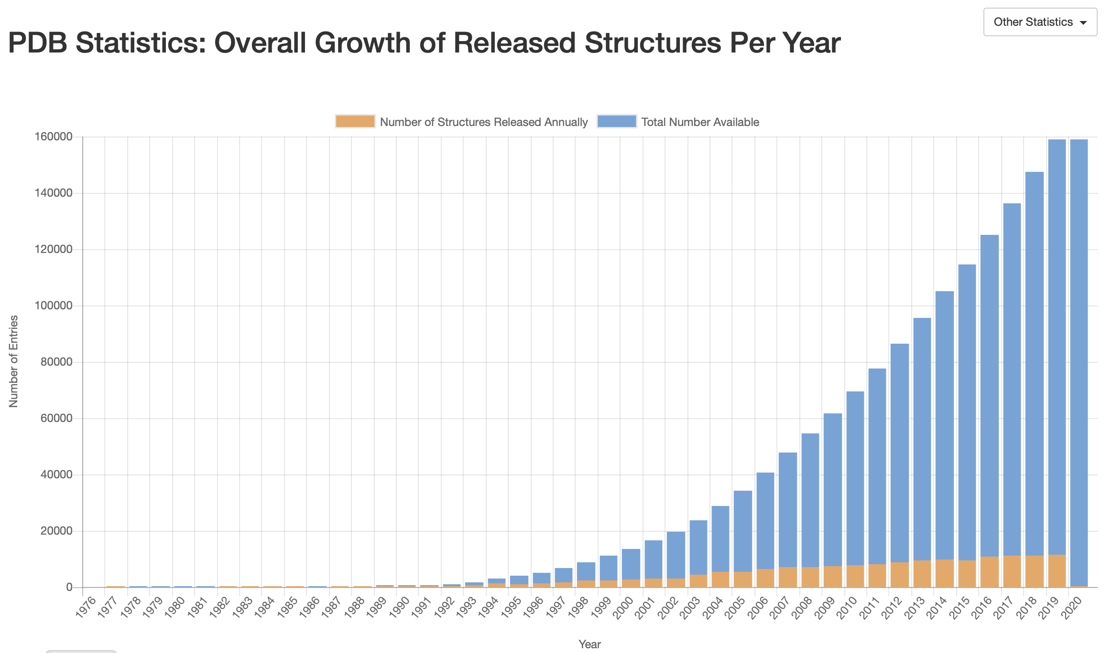
The exponential growth of biomacromolecule structures is an opportunity for SBDD
https://www.rcsb.org/stats/growth/overall

Slide 3
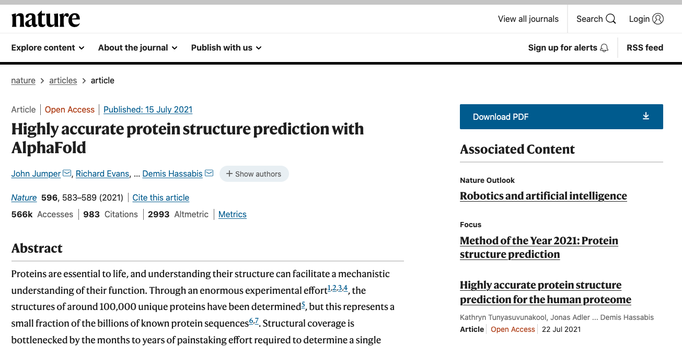
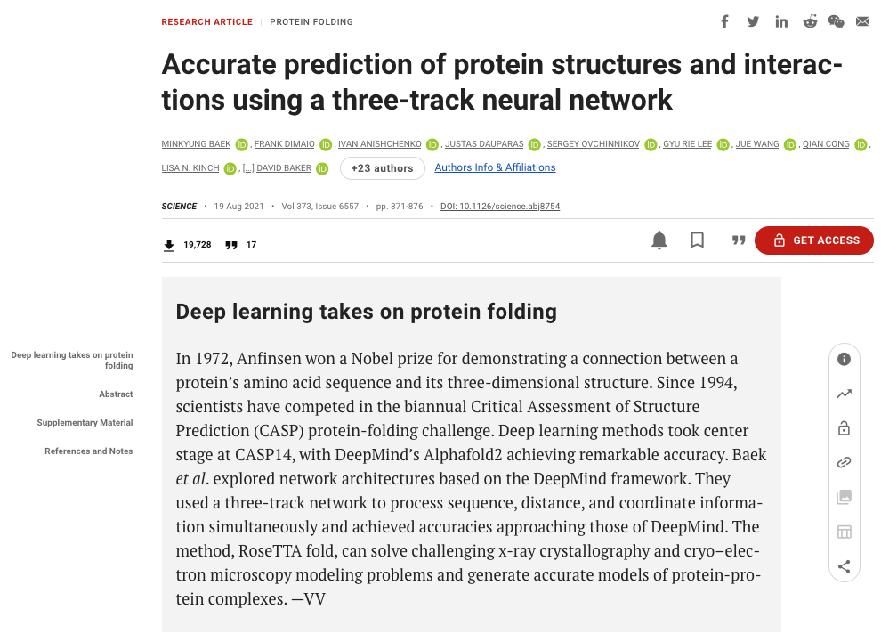
Predictive structural modeling further expands the range of accessible targets

Slide 4
What is necessary/desirable about the physiological role of a SBDD target?

Slide 5
What is necessary/desirable about the physiological role of a SBDD target?
Disease Relevance. Altering activity (usually by inhibition) should affect disease progression.

Slide 6
Brainstorm: How can disease relevance be predicted?

Slide 7
How can disease relevance be predicted?
Mechanistic rationale, e.g.
the enzyme HIV protease has key role in viral life cycle. blocking it will slow viral reproduction.
the H+/K+-ATPase system is involved in stomach acid production. blocking it will reduce stomach acid and can be used to treat acid reflux.
Mutations in a protein known to affect disease progression
in the clinic
in the laboratory
Chemical probes affect disease progression
Essential targets are better, e.g. NADH:ubiquinone oxidoreductase (NQR) is essential for Vibrio cholerae (common gut infection in developing tropical countries) and Chlamydia trachomatis (common STD) [1] but not Pseudomonas aeruginosa (common hospital infection)
Liang, P.; Rosas-Lemus, M.; Patel, D.; Fang, X.; Tuz, K.; Juárez, O. Dynamic Energy Dependency of Chlamydia Trachomatis on Host Cell Metabolism during Intracellular Growth: Role of Sodium-Based Energetics in Chlamydial ATP Generation. J. Biol. Chem. 2018, 293 (2), 510–522. https://doi.org/10.1074/jbc.M117.797209.

Slide 8
Brainstorm: What is necessary/desirable about the structural properties of a SBDD target?

Slide 9
What is necessary about the structural properties of a SBDD target?
High-resolution structure available
Resolution of < 2.5 Å [1]
Homology models less trustworthy
can still be useful, perhaps to guide structure determination
Experimental structures/homology models can be refined by molecular dynamics simulation
“Druggable”
precedence - previously targeted
structure-based
cavities or pockets
comparing physicochemical and geometric properties of pocket with known druggable targets
as a caveat, concept is about history and does not account for innovation
[1] Anderson, A. C. The Process of Structure-Based Drug Design. Chemistry & Biology 2003, 10 (9), 787–797. https://doi.org/10.1016/j.chembiol.2003.09.002.

Slide 10
What is desirable about the structural properties of a SBDD target?
Small
less ambiguity regarding binding site
more amenable to molecular simulation
Rigid
molecular docking is more accurate
molecular simulation requires less sampling
Binding site is
unique, favoring specificity
evolutionarily conserved, less susceptible to resistance

Slide 11
There are multiple online databases to help you identify suitable targets
The Special Programme for Research and Training in Tropical Diseases (TDR) Targets (https://tdrtargets.org/) - A database that allows you to apply various filters to identify drug targets. Focuses on neglected tropical diseases.
Therapeutic target database (http://idrblab.net/ttd/) - “A database to provide information about the known and explored therapeutic protein and nucleic acid targets, the targeted disease, pathway information and the corresponding drugs directed at each of these targets.” This can help you determine precedence for a target.
BindingDB (http://www.bindingdb.org/bind/index.jsp) - “BindingDB is a public, web-accessible database of measured binding affinities, focusing chiefly on the interactions of protein considered to be drug-targets with small, drug-like molecules.” BindingDB can help you determine whether a any small molecule (not necessarily a drug) has been found that binds to a target.

Slide 12
Interactive Database Exercise

Slide 13
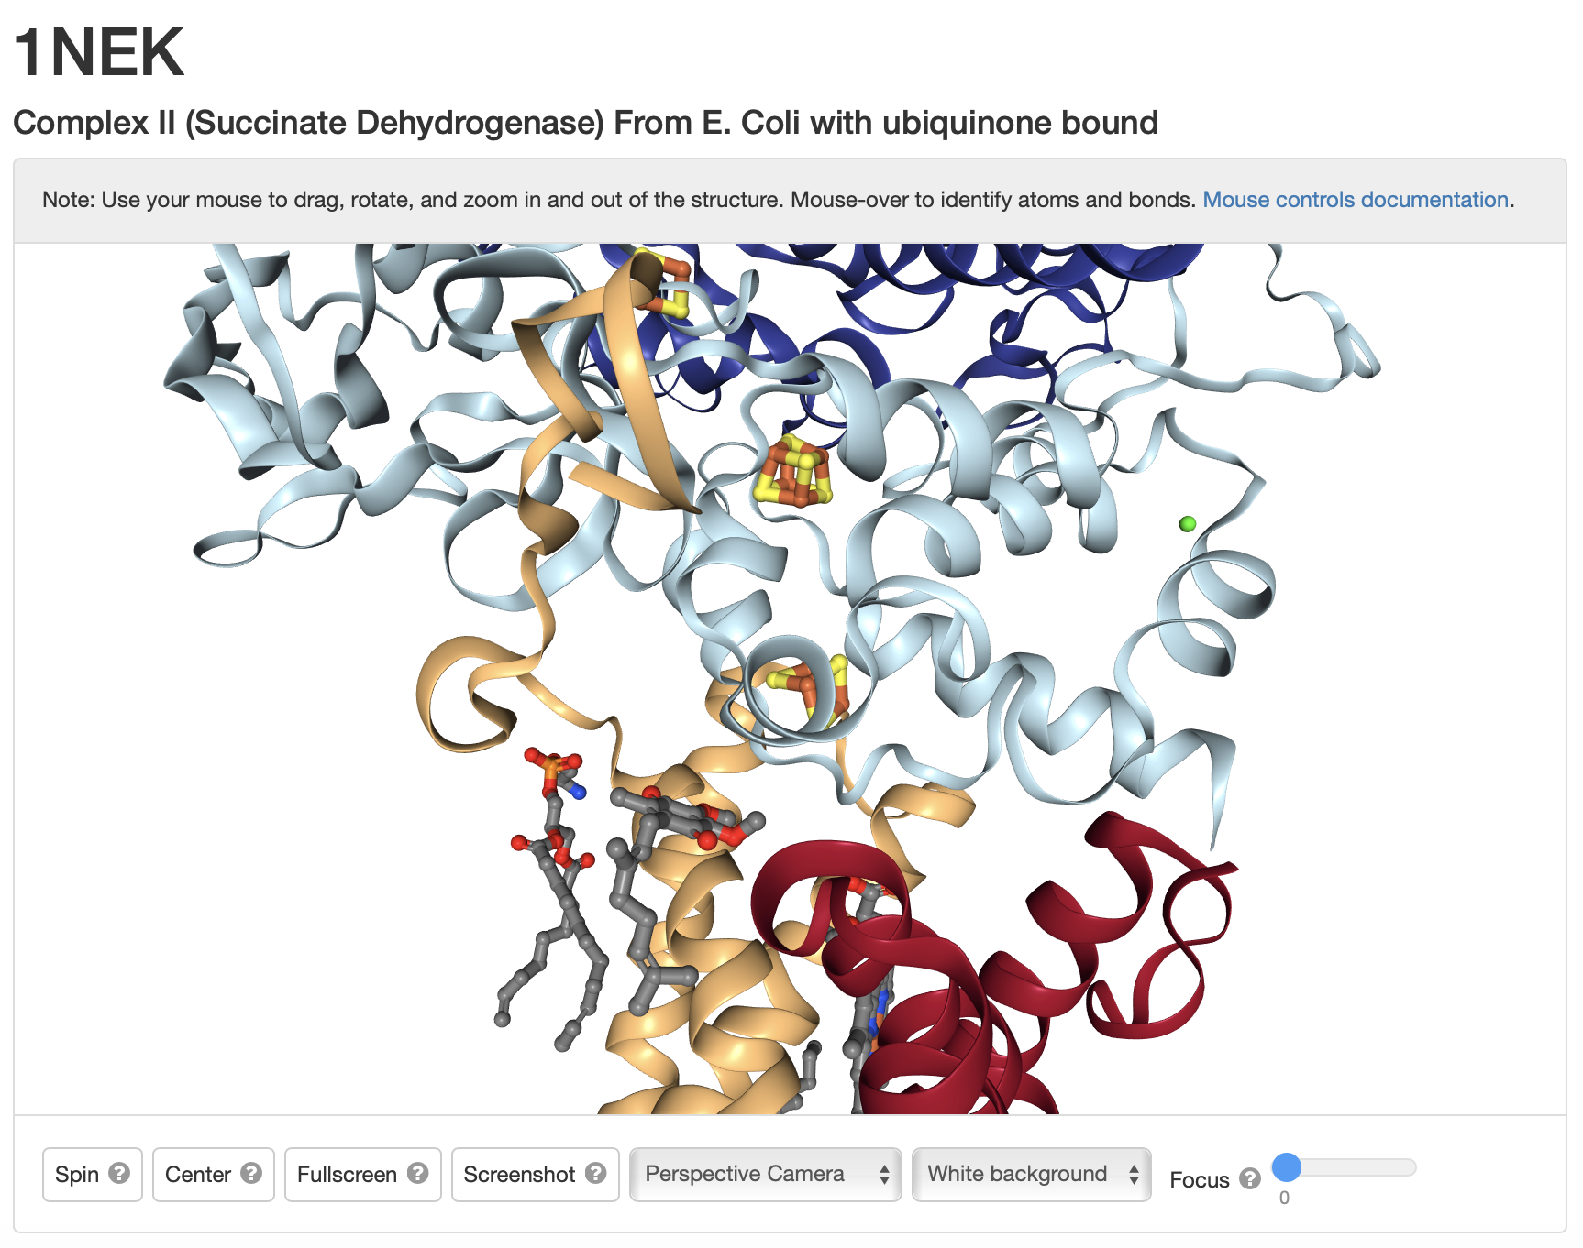
Oscar Juarez has worked on discovering inhibitors for Complex II, a.k.a. Succinate Dehydrogenase (SDH), from Pseudomonas aeruginosa
The structure of E. Coli SDH has been solved at a resolution of 2.6 Å
Subunit B (cyan) has Iron-Sulfur centers
He has targeted the ubiquinone site at the interface of subunits B, C (yellow), and D (red)

Slide 14
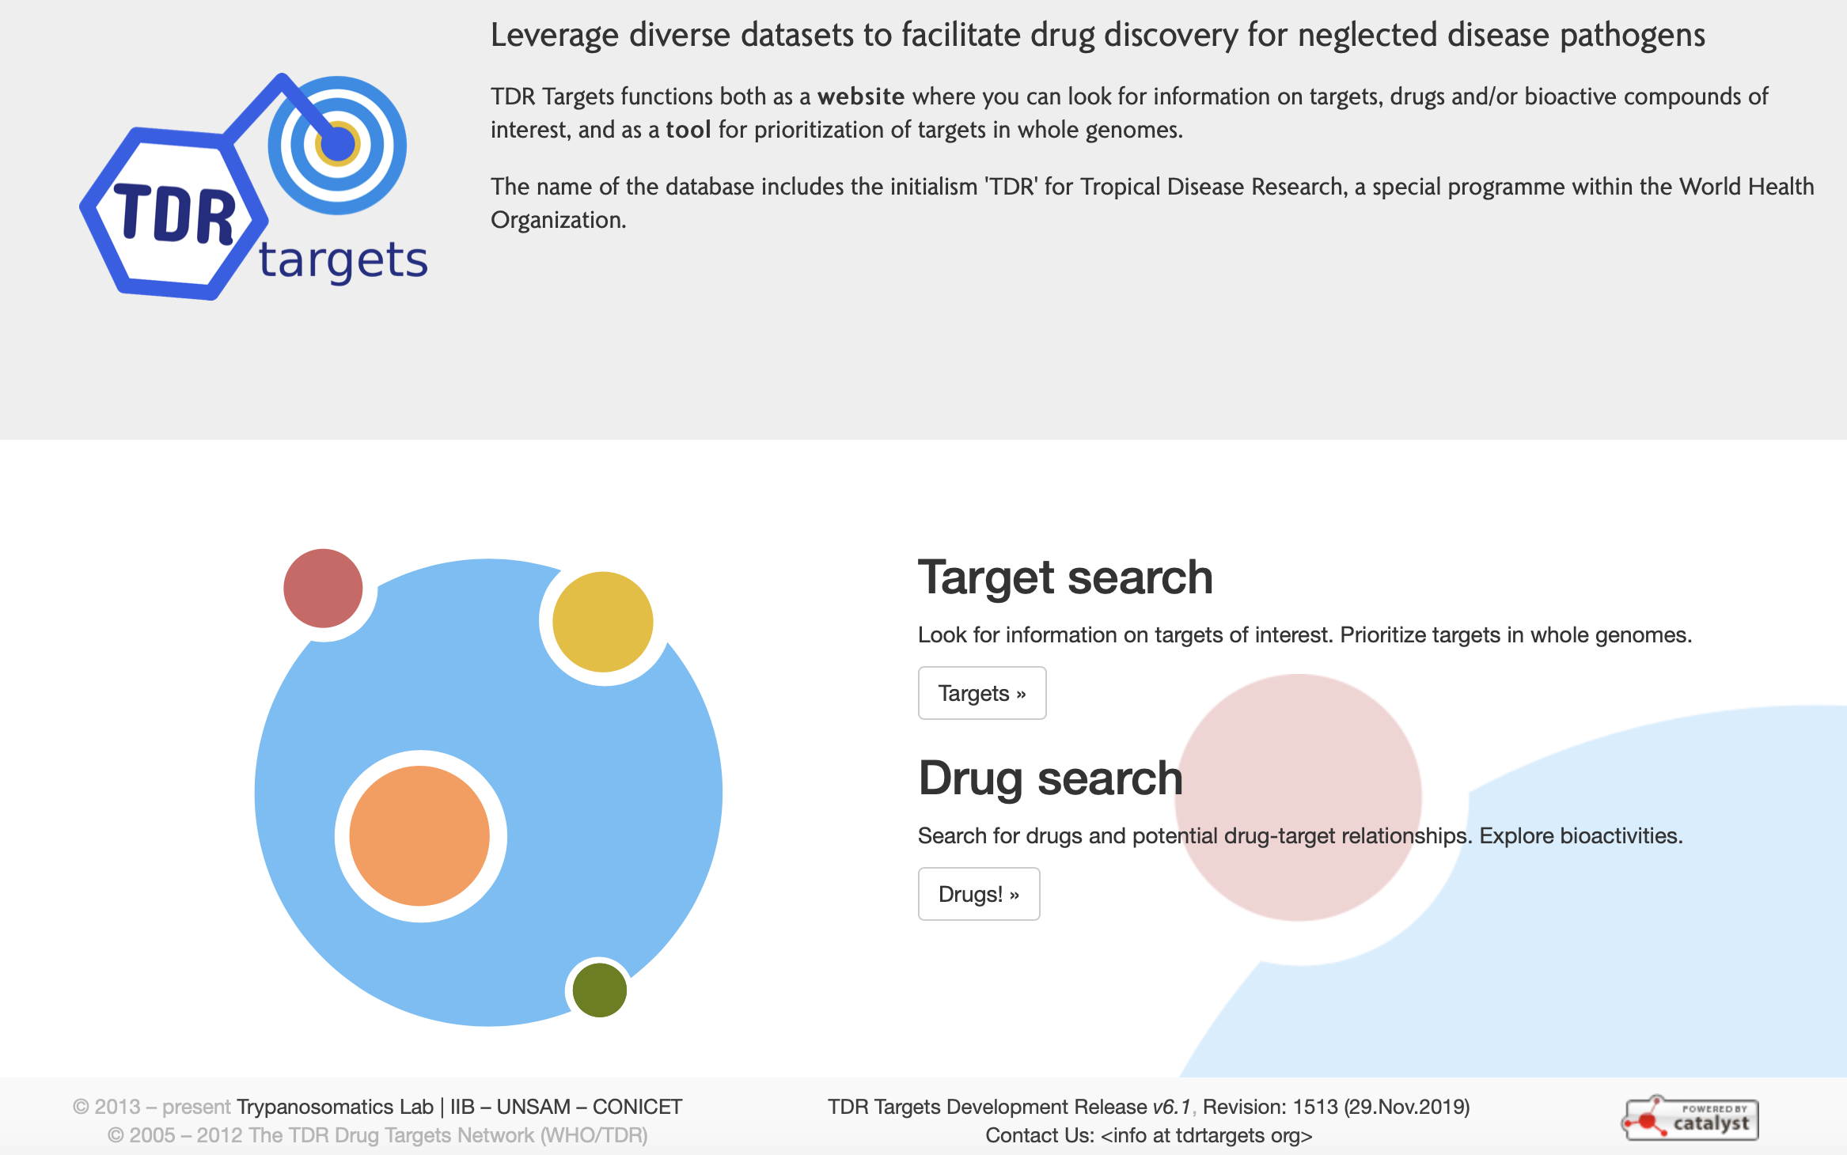
We think it’s a good drug target but I want to see what the online databases suggest
First, let’s try TDR targets (https://tdrtargets.org). It is possible that an SDH drug for P. Aeruginosa may also work on some neglected tropical diseases.

Slide 15
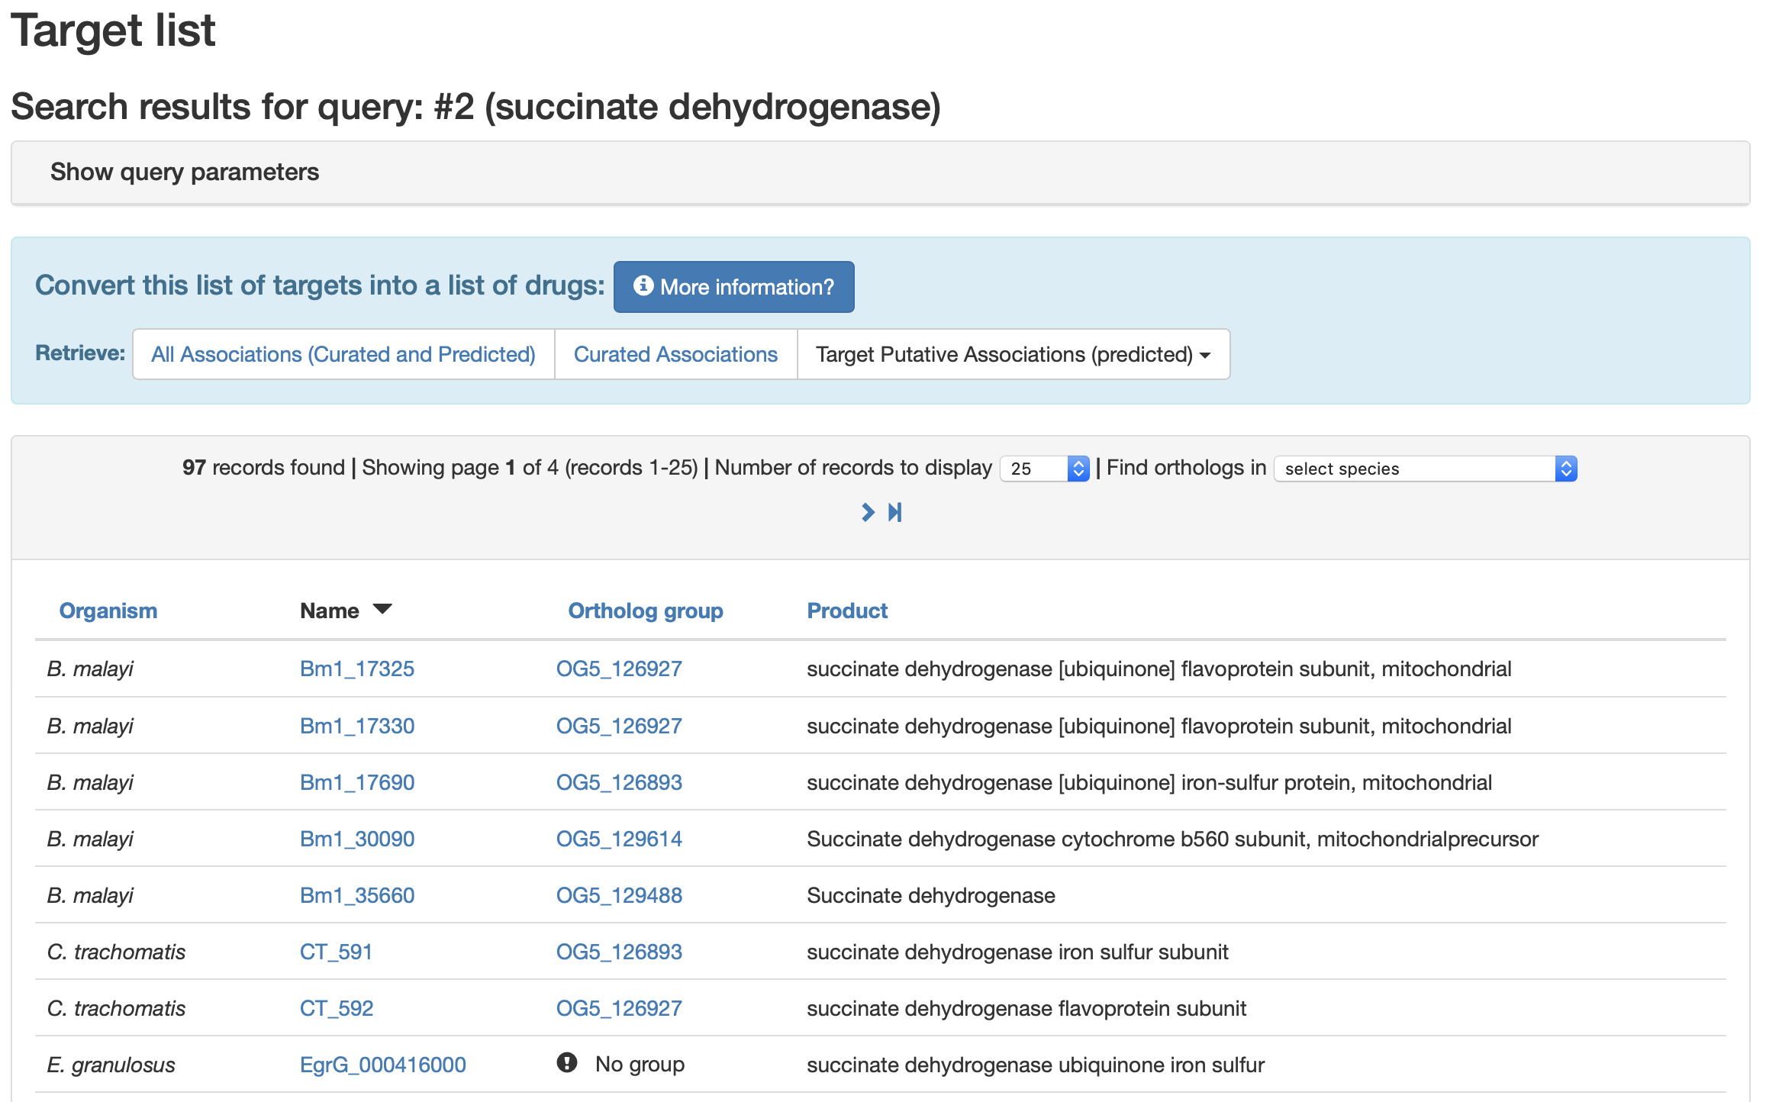
Try a “Quick Search…” for “succinate dehydrogenase”. This yields many results that are various subunits of the enzyme from different species
Compared to the ubiquinone binding site, the “flavoprotein subunit” is on the opposite side of the complex

Slide 16
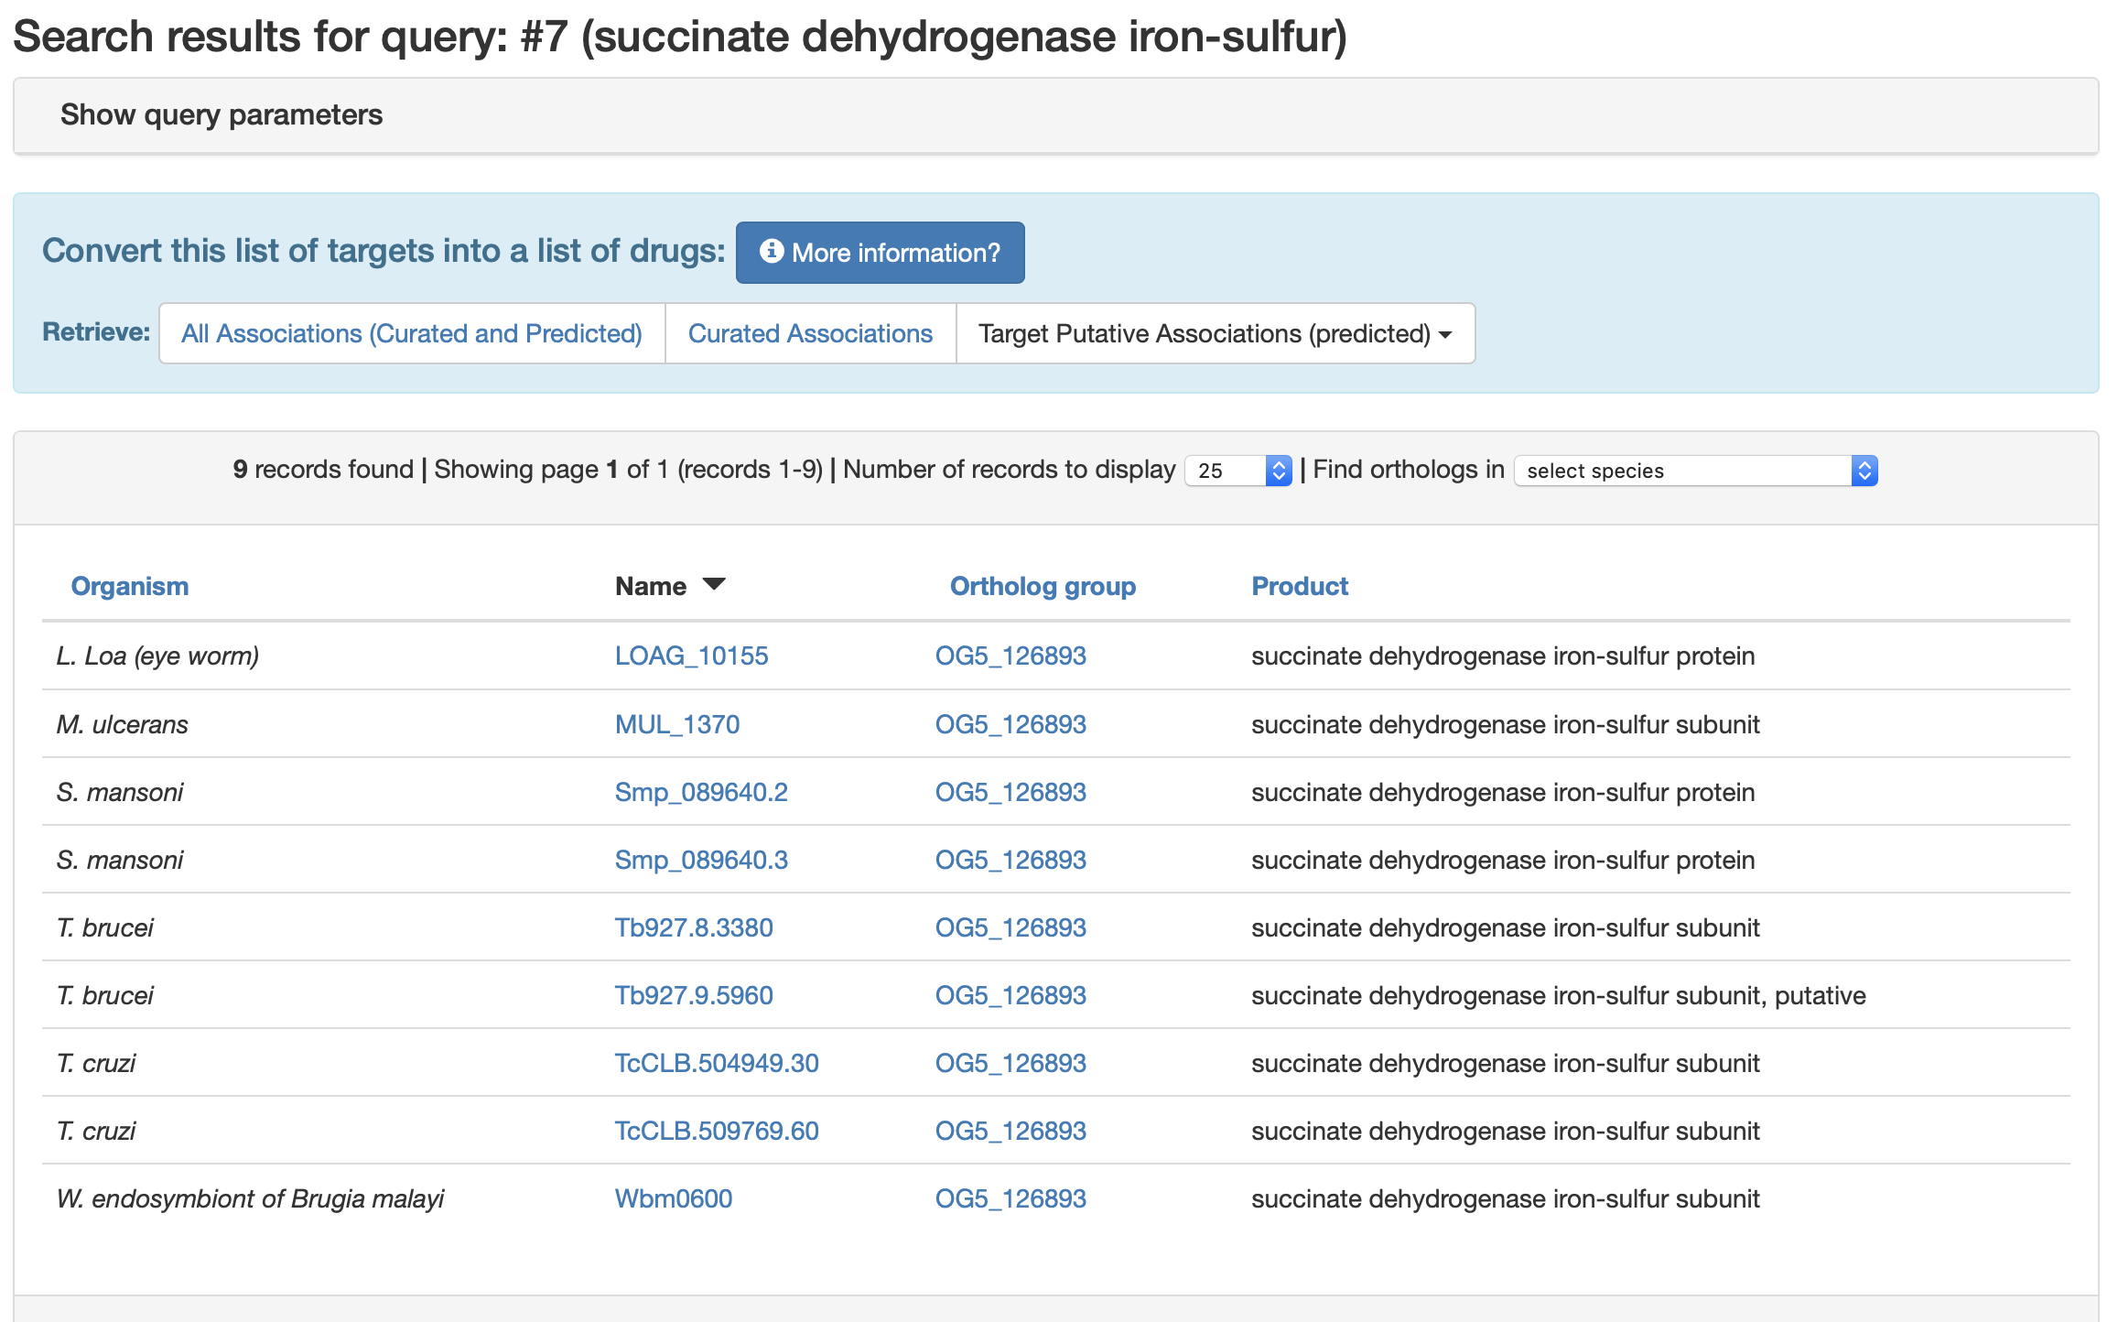
A few of the hits had “iron-sulfur subunit” in the name. The iron-sulfur subunit is B, one of those next to the ubiquinone binding site.
Try a “Quick Search…” for “succinate dehydrogenase iron-sulfur”.

Slide 17
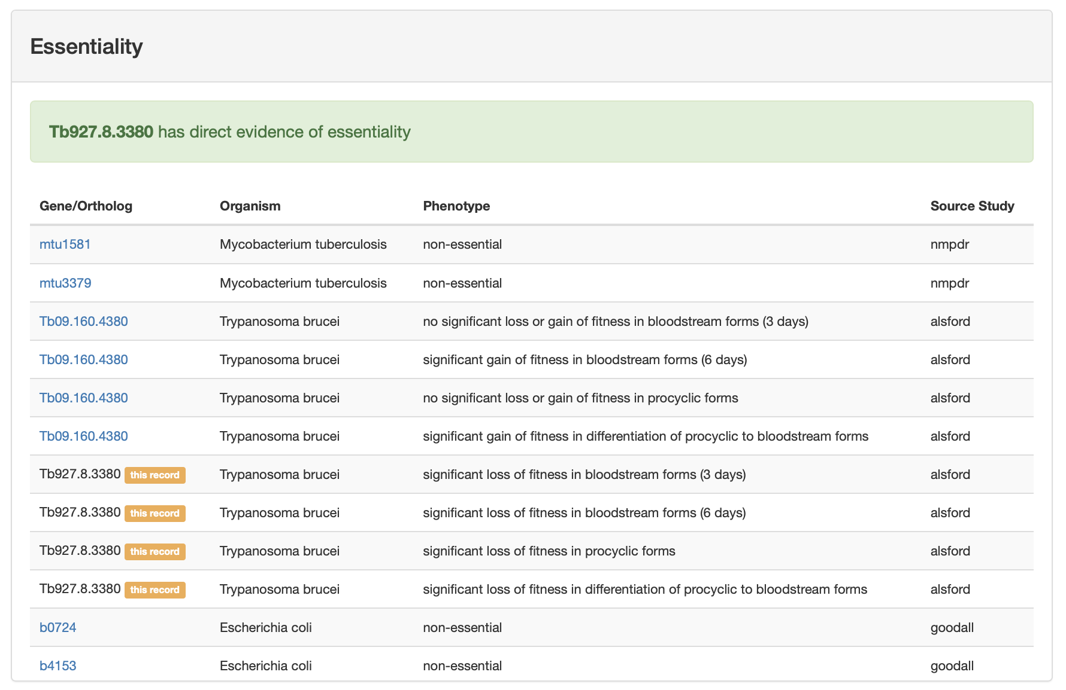
Click on Tb927.8.3380 and scroll down to Essentiality Data
Suppose that we discover a SDH inhibitor in our SBDD campaign against the ubiquinone binding site of P. Aeruginosa. Based on these data, which other species would be most worth testing its efficacy against? Which would be least worth testing?

Slide 18
Click on Tb927.8.3380 and scroll down to Essentiality Data
Suppose that we discover a SDH inhibitor in our SBDD campaign against the ubiquinone binding site of P. Aeruginosa. Based on these data, which other species would be most worth testing its efficacy against? Which would be least worth testing?
The inhibitor should be tested against T. brucei and T. gondii. It probably won’t be effective against M. tuberculosis and P. berghei.

Slide 19
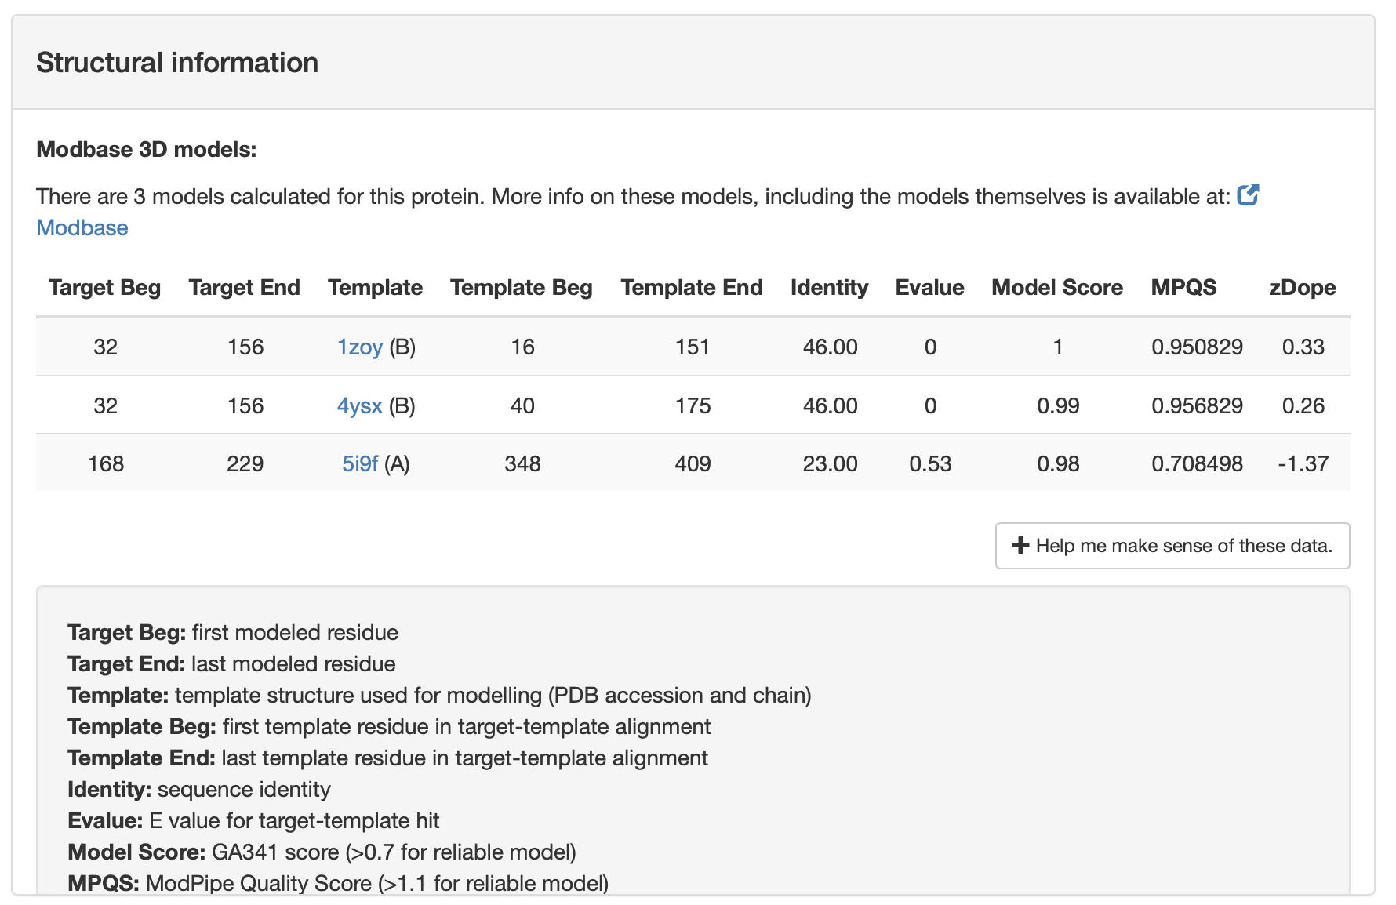
Also take a look at “Structural information”
There is no crystal structures and the homology models from Modbase are not high quality. The homology model could be a guide, but I would not base an SBDD campaign against a T. brucei homology model.
We can also look at AlphaFold

Slide 20
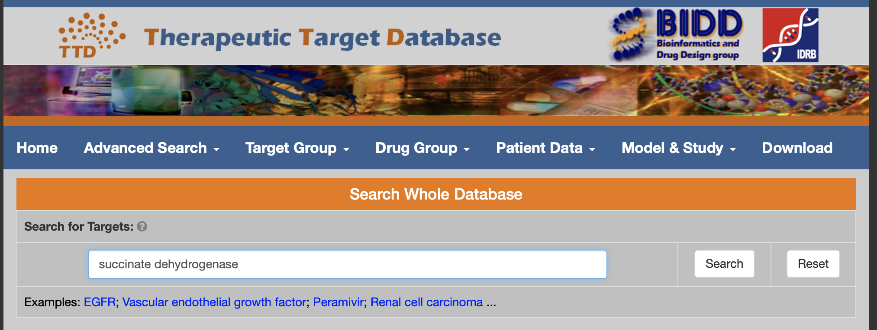
Let’s try “succinate dehydrogenase” in the Therapeutic Target Database (http://idrblab.net/ttd/)
Did you find SDH?

Slide 21
Now try “succinate dehydrogenase” in the Therapeutic Target Database (http://idrblab.net/ttd/)
Did you find SDH?
Looks like it is there, as T39811.

Slide 22
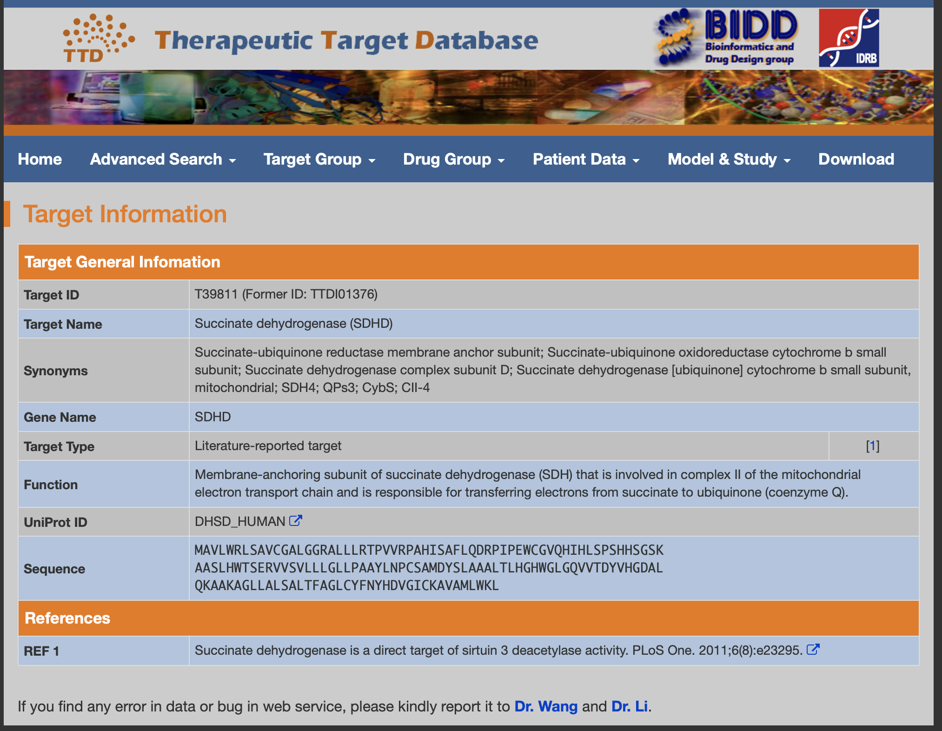
Are there currently any drugs that target SDH?

Slide 23
Are there currently any drugs that target SDH?
No

Slide 24
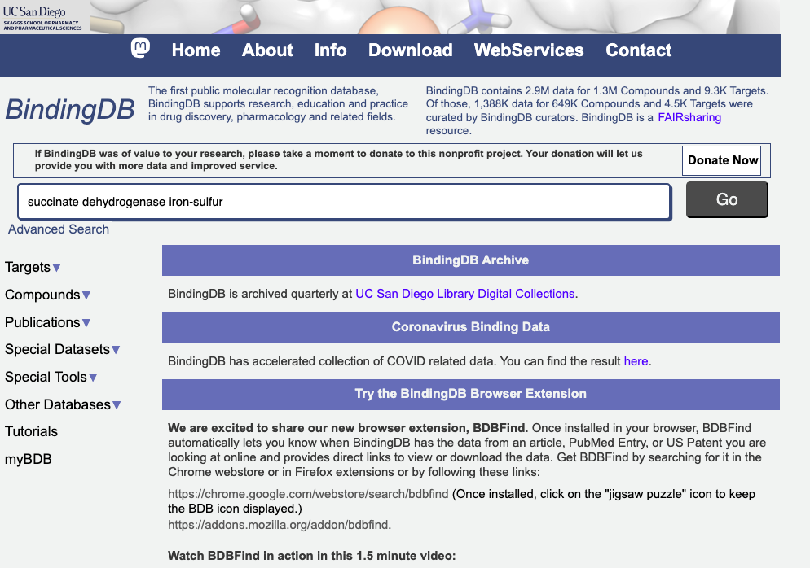
Finally let’s try BindingDB (http://www.bindingdb.org/bind/index.jsp)
Search for “succinate dehydrogenase iron-sulfur”. Then click on “iron-sulfur subunit of complex ii”.
How many hits do you get?

Slide 25
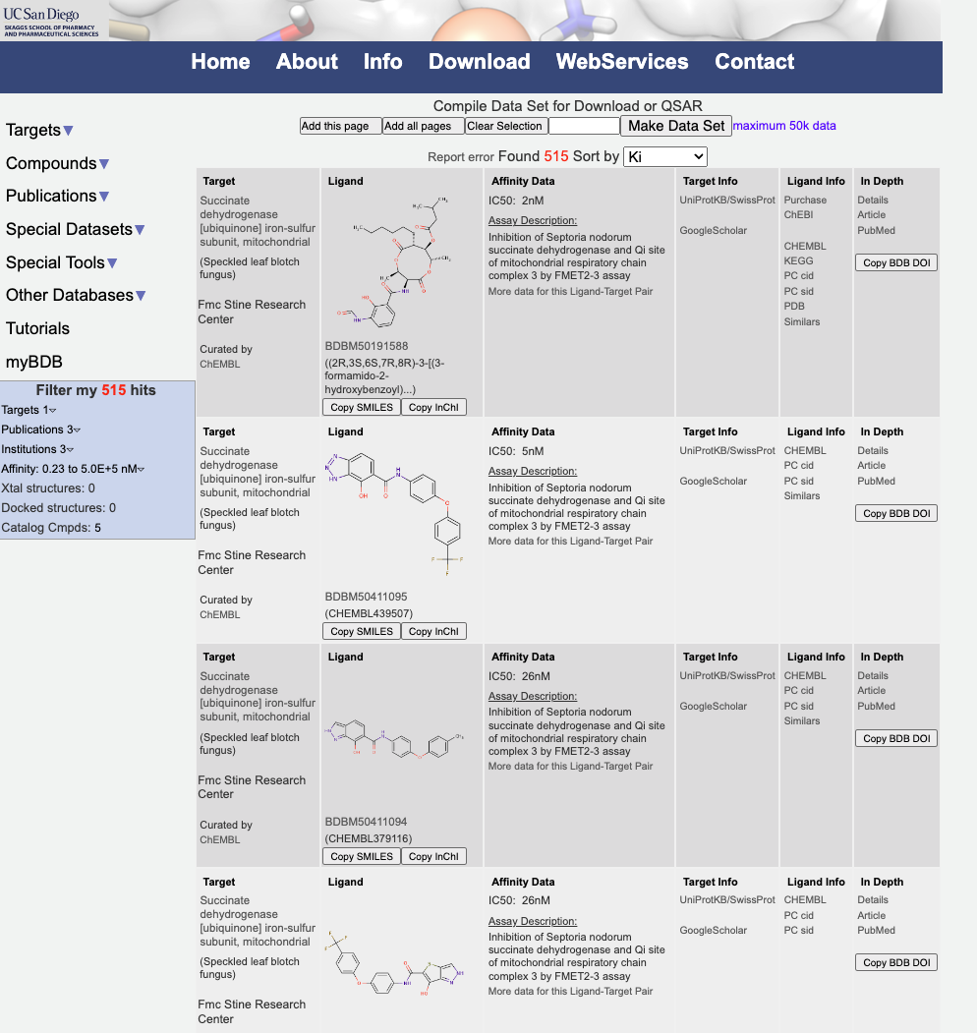
Finally let’s try BindingDB (http://www.bindingdb.org/bind/index.jsp)
Search for “succinate dehydrogenase iron-sulfur”. Then click on “iron-sulfur subunit of complex ii”.
How many hits do you get?
I see 515!

Slide 26
What do I learn from the BindingDB hits?
The relatively large number of compounds that bind to SDH suggests that the site is druggable
The results are from three studies, one that tested inhibition for a bacterium Septoria tritici and two for humans. The fact that many compounds bind to the human enzyme means that specificity could be an issue.
It may be worth trying some of the compounds against P. Aeruginosa.

Slide 27
In the pharmaceutical industry, target selection is not only based on science, but also business
How do pharmaceutical companies make money?
Costs
research and development is very expensive
manufacturing is relatively cheap
Income from drug sales
In the current system, research and development(opposed to making old drugs) is incentivized by patents
must be novel, non-obvious, and useful. usually true for drugs.
provide monopoly on legal sales for a temporary period (in the U.S., 20 years from earliest filing)
need to be filed country-by-country
In general, this system means that for a drug development campaign, the market must be
large enough
rich enough
not too competitive

Slide 28
Review questions
What is necessary and what is desirable for a biological macromolecule to be a suitable target for structure-based drug design?
What is necessary/desirable about the physiological role?
What is necessary/desirable about the structural properties?
What are some business considerations that pharmaceutical companies use to decide whether to develop a drug for a particular target?
What are some databases that you can use to help find a suitable target?

